Slide 1
INCIDENT LIFECYCLE – APPROVAL APP
Notes:
IBM Big Data & Analytics
© 2013 IBM Corporation

Slide 2
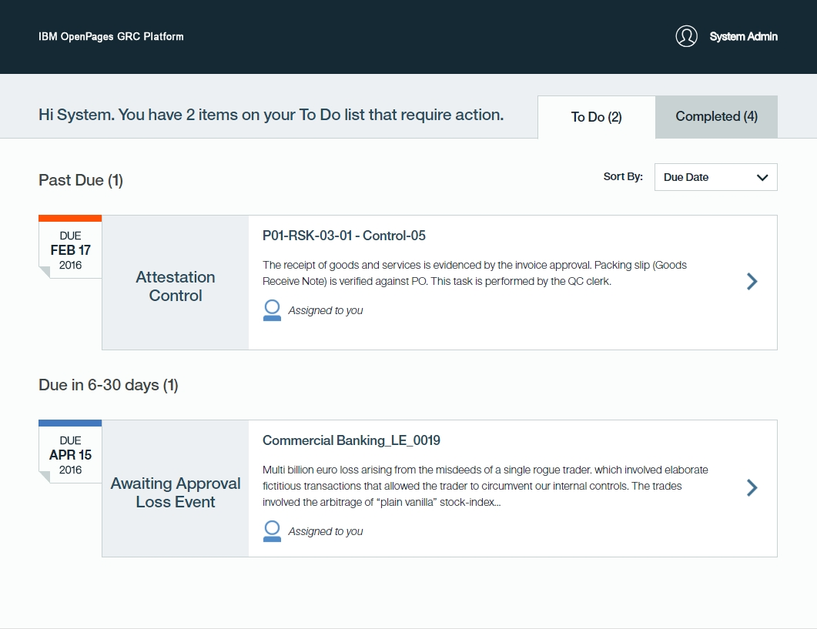
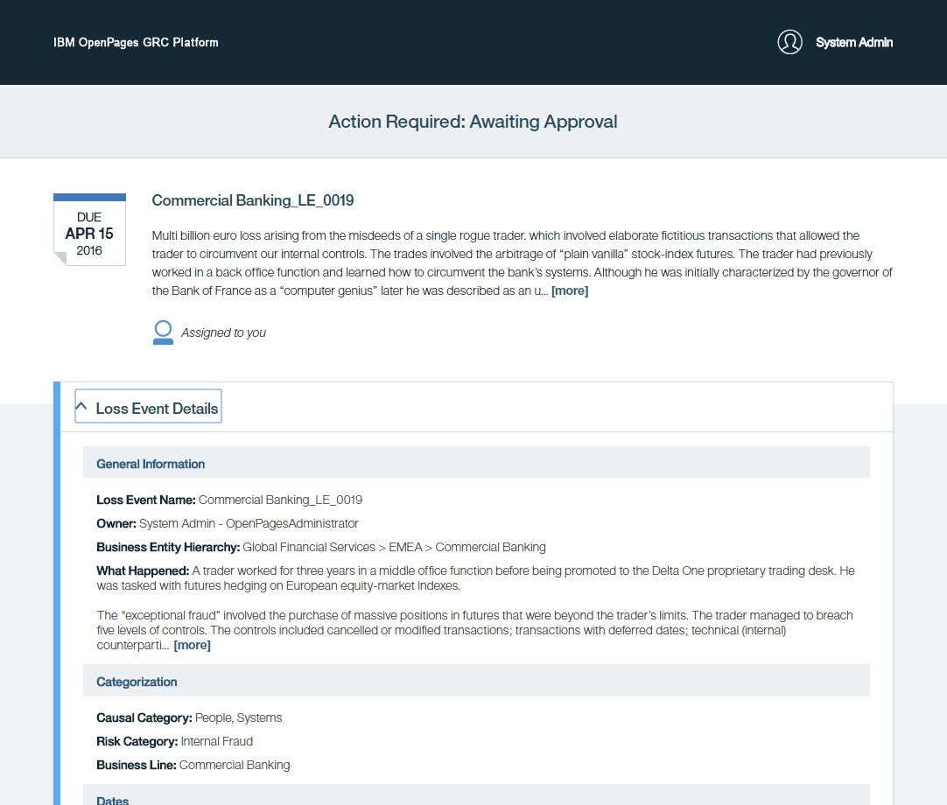
Approval – App
Upon notification, a casual or infrequent user is motivated to take action on a review, approval, or attestation request quickly, with confidence and full knowledge of the context surrounding the request.

Slide 3
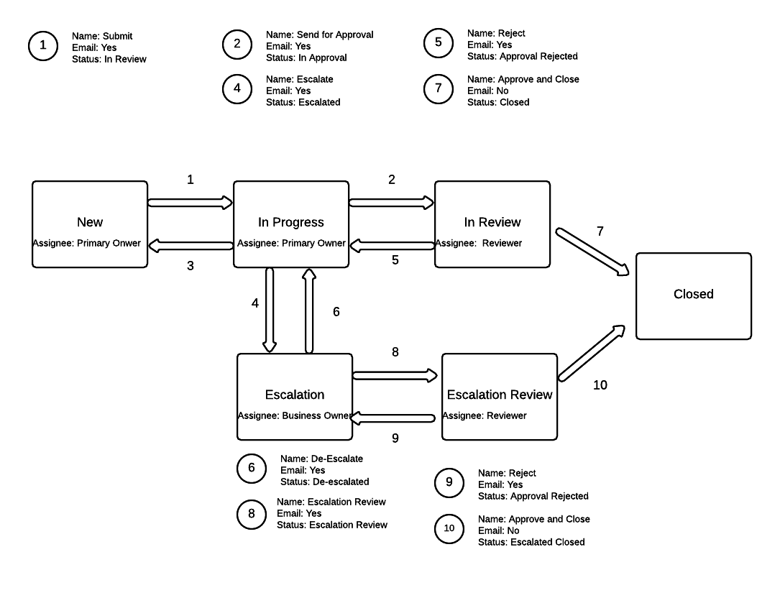
Incident
Default Lifecycle
3 Stage workflow
Escalation Path
Automatic email notification
Stage, status User Comment automatically driven by the lifecycle

Slide 4
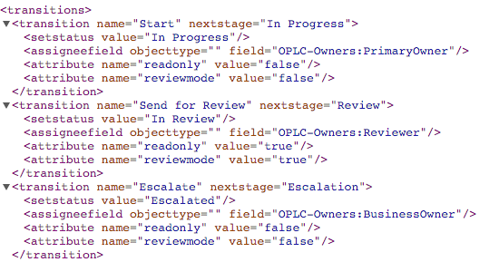
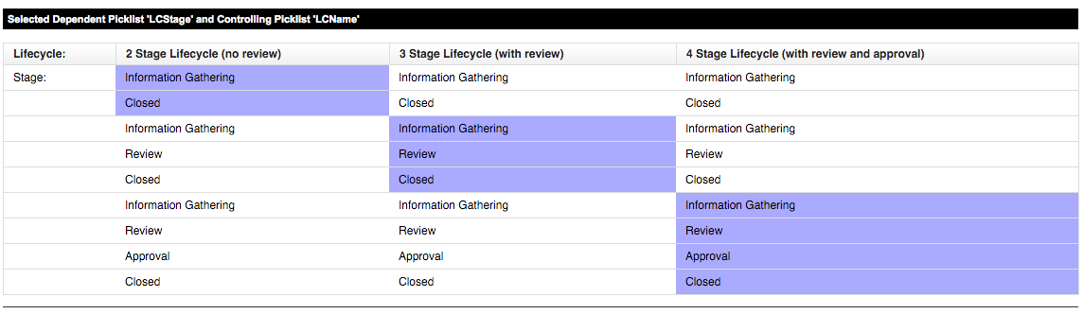
Lifecycle for other objects
Issue, Loss Events, Action Item,
Lifecycle framework is based on 2 key component
  Shared group leveraged by the UI
  Triggers by Objects
Optional RLS extend rule for Assignee
  Assignee being the person requested to work on the object at the current stage

Slide 5
Useful links
Approval App description
https://www.ibm.com/support/knowledgecenter/en/SSFUEU_7.2.0/com.ibm.swg.ba.cognos.op_grc_nfg.7.2.0.doc/c_op_nfg_72fp1_deck.html
Change of Json: https://www.ibm.com/support/knowledgecenter/en/SSFUEU_7.2.0/com.ibm.swg.ba.cognos.op_grc_fix_pack_7201_installer.7.2.0.1.doc/t_op_adm_cnfg_jsn.html

